Slide 1
Data Mining: Concepts and Techniques — Chapter 3 —
Jiawei Han, Micheline Kamber, and Jian Pei
University of Illinois at Urbana-Champaign
Simon Fraser University
©2011 Han, Kamber, and Pei. All rights reserved.

Slide 2
Chapter 3 Data Preprocessing
Data Preprocessing: An Overview
Data Quality
Major Tasks in Data Preprocessing
Data Cleaning
Data Integration
Data Reduction
Data Transformation and data discretization

Slide 3
Why Data Preprocessing?
Data in the real world is dirty
• incomplete: lacking attribute values, lacking certain attributes of interest, or containing only aggregate data
• e.g., occupation=“ ”
• noisy: containing errors or outliers
• e.g., Salary=“-10”
• inconsistent: containing discrepancies in codes or names
• e.g., Age=“42” Birthday=“03/07/1997”
• e.g., Was rating “1,2,3”, now rating “A, B, C”
• e.g., discrepancy between duplicate records

Slide 4
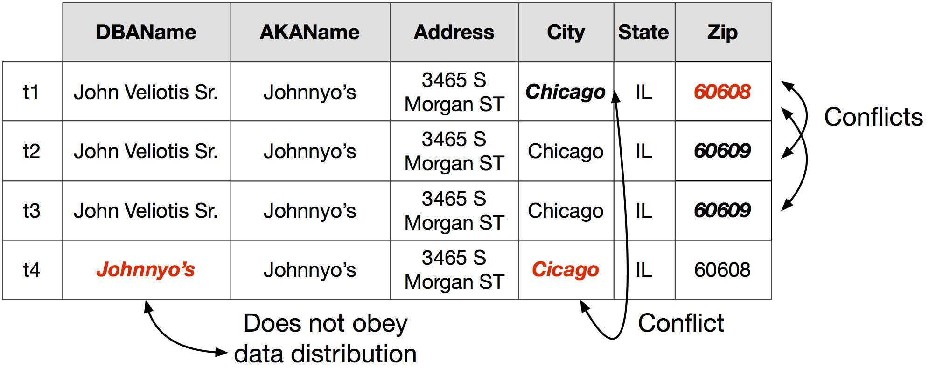

Slide 5
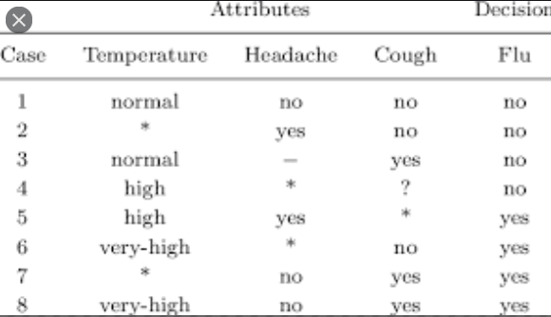

Slide 6
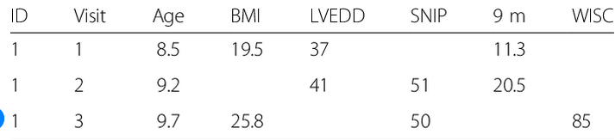

Slide 7
Why is Data Dirty?
• Incomplete data may come from
• “Not applicable” data value when collected
• Different considerations between the time when the data was collected and when it is analyzed.
• Human/hardware/software problems
• Noisy data (incorrect values) may come from
• Faulty data collection instruments
• Human or computer error at data entry
• Errors in data transmission
• Inconsistent data may come from
• Different data sources
• Functional dependency violation (e.g., modify some linked data)
• Duplicate records also need data cleaning

Slide 8
Why is Data Preprocessing Important?
• No quality data, no quality mining results!
Quality decisions must be based on quality data
e.g., duplicate or missing data may cause incorrect or even misleading statistics.
Data warehouse needs consistent integration of quality data
• Data extraction, cleaning, and transformation comprises the majority of the work of building a data warehouse

Slide 9
Major Task in Data Preprocessing
• Data cleaning
• Fill in missing values, smooth noisy data, identify or remove outliers, and resolve inconsistencies
• Data integration
• Integration of multiple databases, data cubes, or files
• Data transformation
• Normalization and aggregation
• Data reduction
• Obtains reduced representation in volume but produces the same or similar analytical results
• Data discretization
• Part of data reduction but with particular importance, especially for numerical data

Slide 10
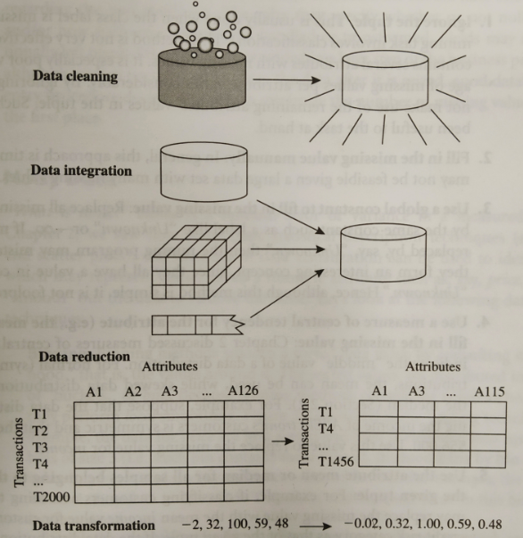

Slide 11
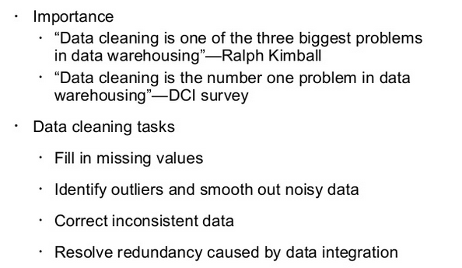
Data Cleaning

Slide 12
Missing Data
• Data is not always available
• E.g., many tuples have no recorded value for several attributes, such as customer income in sales data
• Missing data may be due to
• equipment malfunction
• inconsistent with other recorded data and thus deleted
• data not entered due to misunderstanding
• certain data may not be considered important at the time of entry
• not register history or changes of the data
• Missing data may need to be inferred.

Slide 13
How to handle Missing data?
• Ignore the tuple: usually done when class label is missing (assuming the tasks in classification—not effective when the percentage of missing values per attribute varies considerably.
• Fill in the missing value manually: tedious + infeasible?
• Fill in it automatically with
• a global constant : e.g., “unknown”, a new class?!
• the attribute mean
• the attribute mean for all samples belonging to the same class: smarter
• the most probable value: inference-based such as Bayesian formula or decision tree

Slide 14
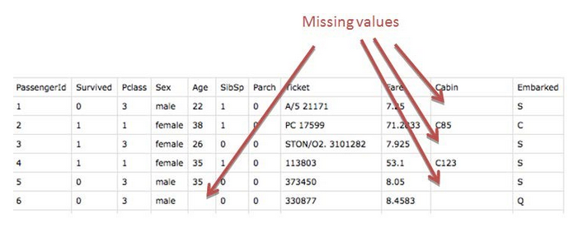
Example

Slide 15
Ignore Tuple
Pros:
Complete removal of data with missing values results in robust and highly accurate model
Deleting a particular row or a column with no specific information is better, since it does not have a high weightage
Cons:
Loss of information and data
Works poorly if the percentage of missing values is high (say 30%), compared to the whole dataset

Slide 16
Replacing With Mean/Mode
Pros:
This is a better approach when the data size is small
It can prevent data loss which results in removal of the rows and columns
Cons:
Imputing the approximations add variance and bias
Works poorly compared to other multiple-imputations method

Slide 17
Assigning An Unique Category
A categorical feature will have a definite number of possibilities, such as gender, for example. Since they have a definite number of classes, we can assign another class for the missing values. Here, the features Cabin and Embarked have missing values which can be replaced with a new category, say, U for ‘unknown’.

Slide 18
Pros:
Less possibilities with one extra category, resulting in low variance after one hot encoding — since it is categorical
Negates the loss of data by adding an unique category
Cons:
Adds less variance
Adds another feature to the model while encoding, which may result in poor performance

Slide 19
Noisy Data
Noise: random error or variance in a measured variable
Incorrect attribute values may due to
faulty data collection instruments
data entry problems
data transmission problems
technology limitation
inconsistency in naming convention
Other data problems which requires data cleaning
duplicate records
incomplete data
inconsistent data
Notes:
19

Slide 20
How to Handle Noisy Data?
Binning
Binning methods smooth a sorted data value by consulting its “neighbor-hood,” that is, the values around it.
first sort data and partition into (equal-frequency) bins
then one can smooth by bin means, smooth by bin median, smooth by bin boundaries, etc.
Regression
smooth by fitting the data into regression functions
Clustering
detect and remove outliers
Semi-automated method: combined computer and human inspection
detect suspicious values and check manually
20
Notes:
20

Slide 21
Simple Discretization Methods: Binning
Equal-width (distance) partitioning
Divides the range into N intervals of equal size: uniform grid
if A and B are the lowest and highest values of the attribute, the width of intervals will be: W = (B –A)/N.
The most straightforward, but outliers may dominate presentation
Skewed data is not handled well
Equal-depth (frequency) partitioning
Divides the range into N intervals, each containing approximately same number of samples
Good data scaling
Managing categorical attributes can be tricky
Notes:
21

Slide 22
Binning Methods for Data Smoothing
Sorted data for price (in dollars):
4, 8, 9, 15, 21, 21, 24, 25, 26, 28, 29, 34
* Partition into equal-frequency (equi-depth) bins:
- Bin 1: 4, 8, 9, 15
- Bin 2: 21, 21, 24, 25
- Bin 3: 26, 28, 29, 34
Smoothing by bin means: each value in a bin is replaced by the mean value of the bin.
- Bin 1: 9, 9, 9, 9
- Bin 2: 23, 23, 23, 23
- Bin 3: 29, 29, 29, 29
Notes:
22

Slide 23
Binning Methods for Data Smoothing
Sorted data for price (in dollars):
4, 8, 9, 15, 21, 21, 24, 25, 26, 28, 29, 34
* Partition into equal-frequency (equi-depth) bins:
- Bin 1: 4, 8, 9, 15
- Bin 2: 21, 21, 24, 25
- Bin 3: 26, 28, 29, 34
* Smoothing by bin boundaries: Each bin value is then replaced by the closest boundary value. In general, the larger the width, the greater the effect of the smoothing.
- Bin 1: 4, 4, 4, 15
- Bin 2: 21, 21, 25, 25
- Bin 3: 26, 26, 26, 34
Notes:
23

Slide 24
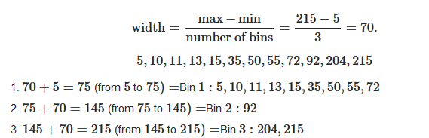
Equal-width partitioning

Slide 25
Regression
Linear regression – find the best line to fit two variables and use regression function to smooth data
Data can be smoothed by fitting the data to a function, such as with regression.
y
Y1
Y1’
y = x + 1
X1
x
Linear regression (best line to fit
two variables)
Multiple linear regression (more
than two variables), fit to a
multidimensional surface
25
Notes:
25

Slide 26
Cluster Analysis
detect and remove outliers, Where similar values are organized into groups or “clusters”
Notes:
26

Slide 28
Data Integration
Data integration:
Combines data from multiple sources into a coherent store
Issues to be considered
Schema integration: e.g., “cust-id” & “cust-no”
Integrate metadata from different sources
Entity identification problem:
Identify real world entities from multiple data sources,
e.g., Bill Clinton = William Clinton
Detecting and resolving data value conflicts
For the same real world entity, attribute values from different sources are different
Possible reasons: different representations, different scales,
e.g., metric vs. British units
Notes:
28

Slide 29
Handling Redundancy in Data Integration
Redundant data occur often when integration of multiple databases is done.
Object identification: The same attribute or object may have different names in different databases (link adharcard and PAN card)
Derivable data: One attribute may be a “derived” attribute in another table, e.g., annual revenue, age
Redundant attributes can be detected by correlation analysis
Careful integration of the data from multiple sources may help reduce/avoid redundancies and inconsistencies and improve mining speed and quality.
Data value conflict detection and resolution
Hotel chain, retail shops, schools, institutes
Tuple duplication – increase redundancy and inconsistancy
Notes:
29

Slide 30
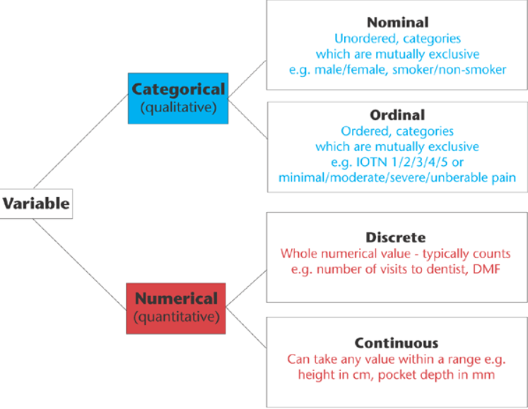
Data

Slide 31
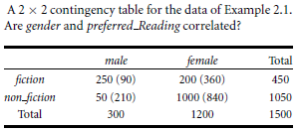




Correlation analysis of categorical (discrete) attributes using chi square.
For given example expected frequency for the cell ( male , Fiction) is:
Chi square computation is :

Slide 32
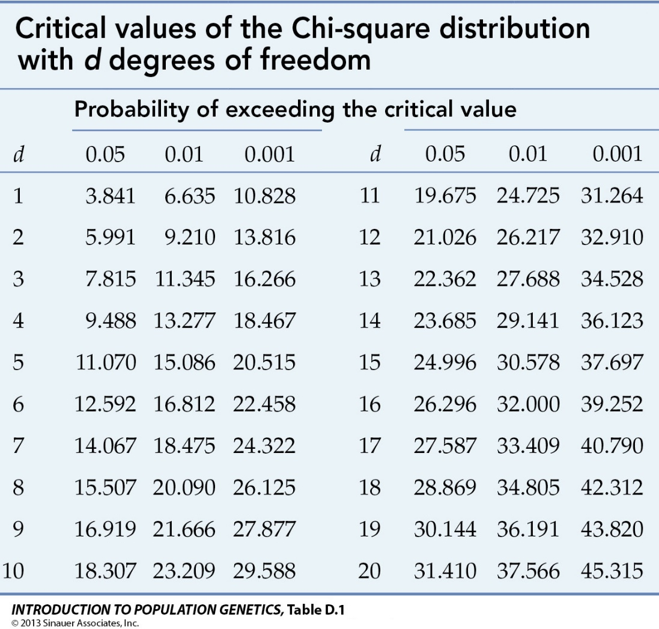
Chi-square distribution table

Slide 33
Goodness of fit test
Stating the Hypothesis
Null Hypothesis: There is no relationship between the two categorical variables. (They are independent.)
Acceptable Hypothesis: There is a relationship between the two categorical variables. (They are not independent.)
Find Degree of freedom = (R-1)*(C-1)
For 1 degree of freedom, the chi square value needed to reject hypothesis at the 0.001 significance level is 10.828.
Check chi-square(calculated) > chi-square(tabular)
Yes – reject null hypothesis and accept alternate hypothesis

Slide 34
Goodness of fit
Our value is above this so we can reject the hypothesis that gender and prefered_reading are independent.
Conclusion - Two attributes are (strongly) correlated for the given group of people.

Slide 35
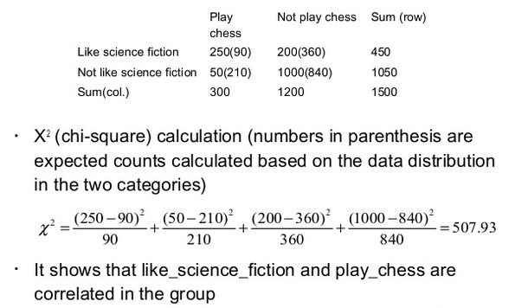
Example :1

Slide 36
Finding the P-Value
Technically, the p-value is the probability of observing χ2 as least as large as the one observed assuming that no relationship exists between the explanatory and response variable. Using statistical software, we find that the p-value for this test.

Slide 37
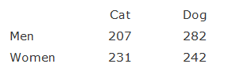
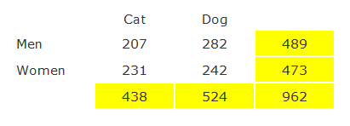
Example 2:

Slide 38
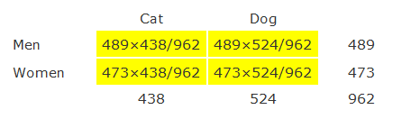
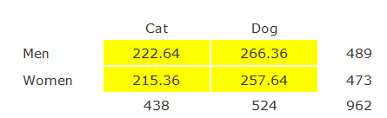

Slide 39
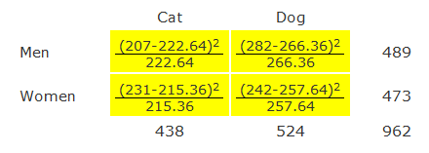
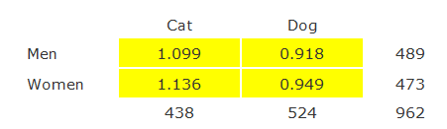


Slide 40
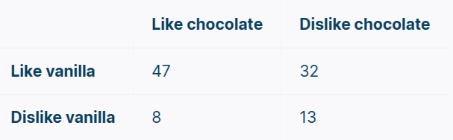
# Exercise :

Slide 41
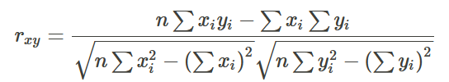
Correlation Analysis (Numerical Data)
Correlation coefficient (also called Pearson’s product moment coefficient)
Where; n is the number of tuples
are the respective means of A and B,
σ_{A} and σ_{B} are the respective standard deviation of A and B,
Σ(AB) is the sum of the AB cross-product.
If r_{A,B} > 0, A and B are positively correlated (A’s values increase as B’s). The higher, the stronger correlation.
r_{A,B} = 0: independent;
r_{A,B} < 0: negatively correlated
n
n
Notes:
41

Slide 42
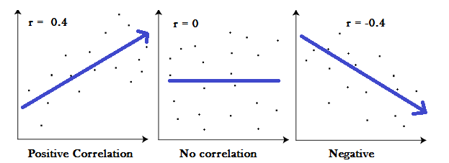
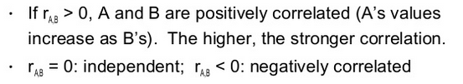

Slide 43
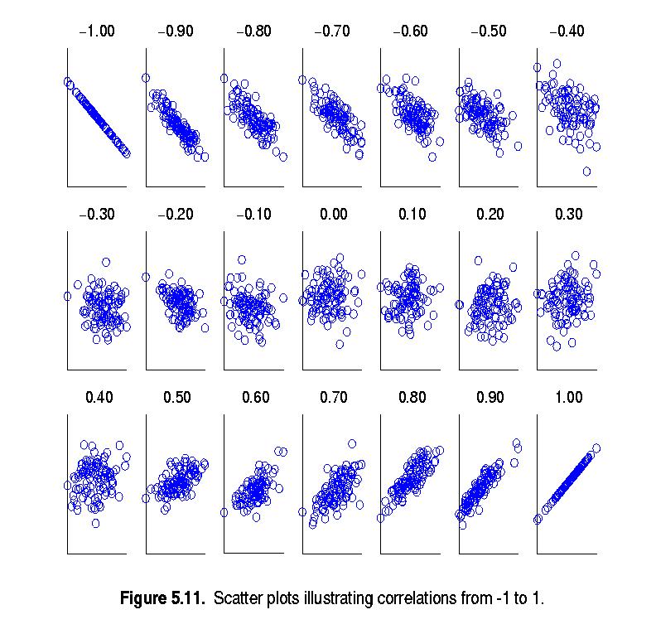
Visually Evaluating Correlation
Scatter plots showing the similarity from –1 to 1.

Slide 44
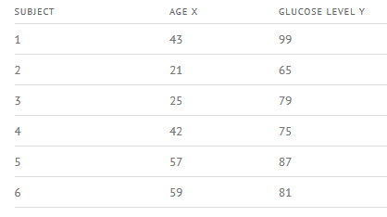

Slide 45
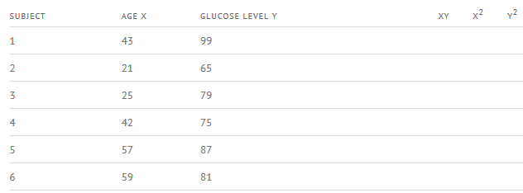

Slide 46
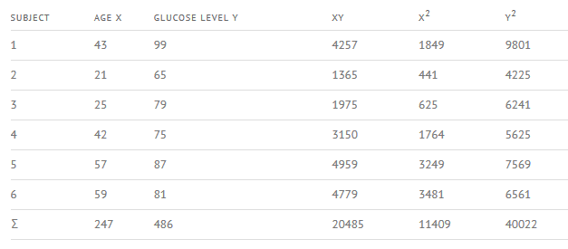

Slide 47
Solution
The answer r is: 2868 / 5413.27 = 0.529809
Σx = 247
Σy = 486
Σxy = 20,485
Σx² = 11,409
Σy² = 40,022
n is the sample size, in our case = 6
The correlation coefficient =
6(20,485) – (247 × 486) / [√[[6(11,409) – (247²)] × [6(40,022) – 486²]]]
= 0.5298
The range of the correlation coefficient is from -1 to 1. Our result is 0.5298 or 52.98%, which means the variables have a moderate positive correlation.

Slide 48

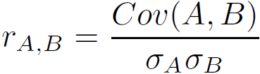
Covariance (Numeric Data)
Covariance is similar to correlation
where n is the number of tuples, and are the respective mean or expected values of A and B, σ_{A} and σ_{B} are the respective standard deviation of A and B.
Positive covariance: If Cov_{A,B} > 0, then A and B both tend to be larger than their expected values.
Negative covariance: If Cov_{A,B} < 0 then if A is larger than its expected value, B is likely to be smaller than its expected value.
Independence: Cov_{A,B} = 0 but the converse is not true:
Some pairs of random variables may have a covariance of 0 but are not independent. Only under some additional assumptions (e.g., the data follow multivariate normal distributions) does a covariance of 0 imply independence
Correlation coefficient:

Slide 49

Co-Variance: An Example
It can be simplified in computation as
Suppose two stocks A and B have the following values in one week: (2, 5), (3, 8), (5, 10), (4, 11), (6, 14).
Question: If the stocks are affected by the same industry trends, will their prices rise or fall together?
E(A) = (2 + 3 + 5 + 4 + 6)/ 5 = 20/5 = 4
E(B) = (5 + 8 + 10 + 11 + 14) /5 = 48/5 = 9.6
Cov(A,B) = (2×5+3×8+5×10+4×11+6×14)/5 − 4 × 9.6 = 4
Thus, A and B rise together since Cov(A, B) > 0.

Slide 50
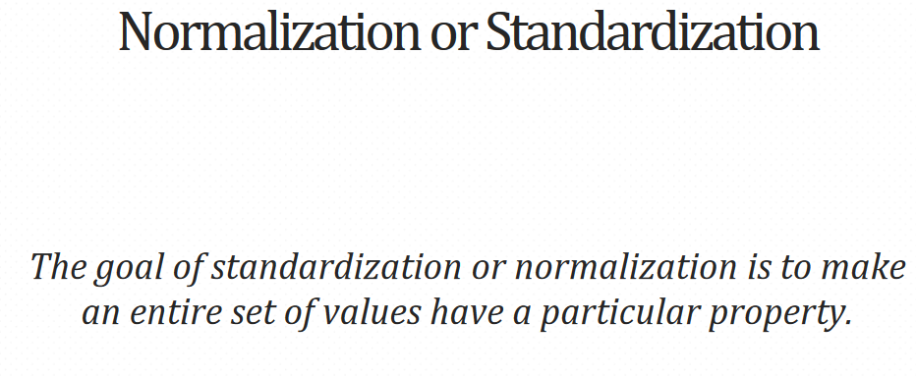

Slide 51
Data Transformation
Smoothing: remove noise from data using smoothing techniques
Aggregation: summarization, data cube construction
Generalization: concept hierarchy climbing
Normalization: scaled to fall within a small, specified range
min-max normalization
z-score normalization
normalization by decimal scaling
Attribute/feature construction:
New attributes constructed from the given ones
51
Notes:
51

Slide 52
Data Transformation: Normalization
Min-max normalization: For Linear Transformation; to [new_min_{A}, new_max_{A}]
Ex. Let income range $12,000 to $98,000 normalized to [0.0, 1.0]. Then $73,600 is mapped to
Z-score normalization (μ: mean, σ: standard deviation):
Ex. Let μ (mean) = 54,000,
σ (std. dev)= 16,000. Then
Normalization by decimal scaling
Where j is the smallest integer such that, Max(|ν’|) < 1
Notes:
52

Slide 53
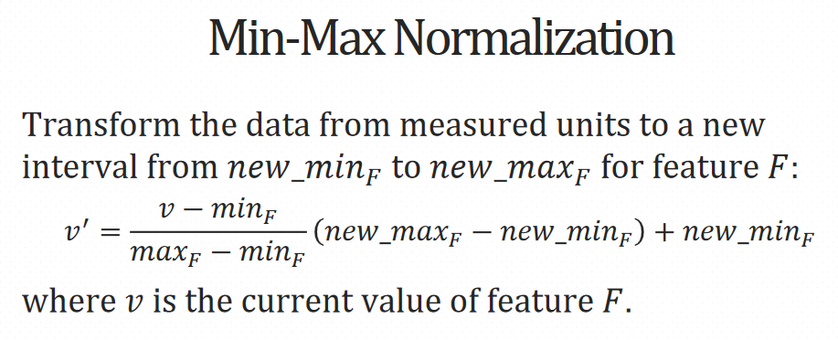

Slide 54

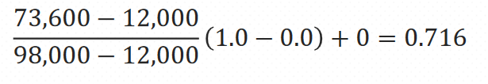
Suppose that the minimum and maximum values for the feature income are $12,000 and $98,000, respectively.
We would like to map income to the range [0.0,1.0]
By min-max normalization, a value of $73,600 for income is transformed to:

Slide 55
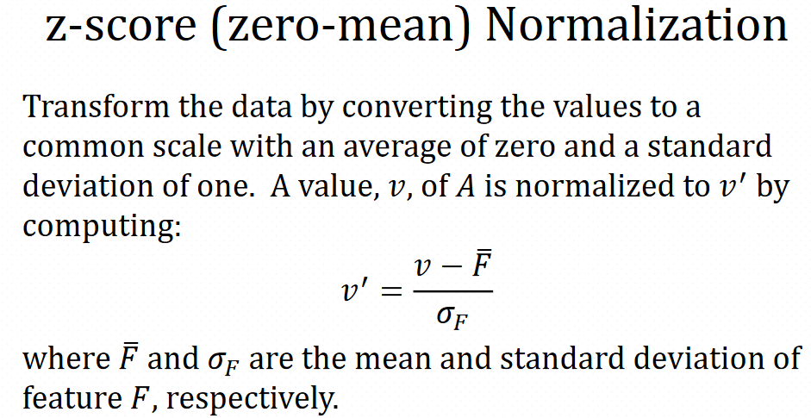

Slide 56
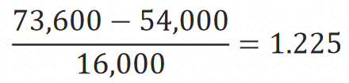
Example
Suppose that the mean and standard deviation of the values for the feature income are $54,000 and $16,000, respectively. With z-score normalization, a value of $73,600 for income is transformed to

Slide 57
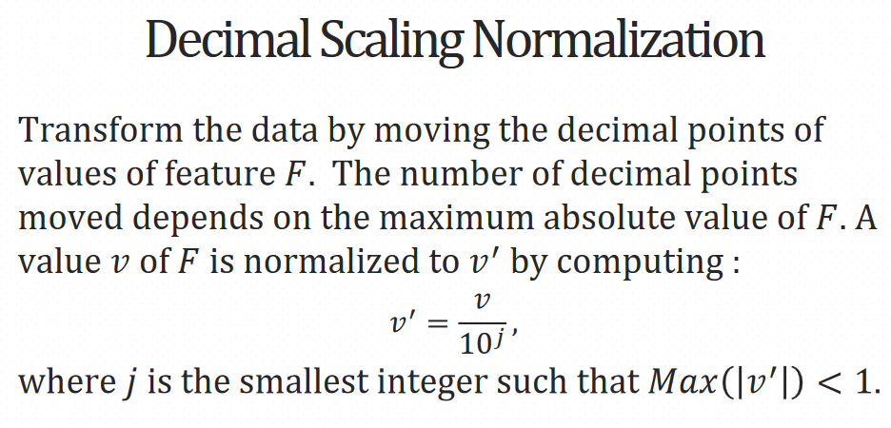

Slide 58
Example
Suppose that the recorded values of 𝐹range from −986to 917.
The maximum absolute value of 𝐹is 986.
To normalize by decimal scaling, we therefore divide each value by 1,000(i.e., 𝑗=3)
so that −986 normalizes to −0.986 and 917 normalizes to 0.917

